Slide 1
HTTP Client (Java 11) and Testing

Slide 2




Thiago Carreira
https://www.linkedin.com/in/tcanascimento
Ramsés Almeida
https://www.linkedin.com/in/rsaccoll

Slide 3
So...What all using to testing microservices (or APIS..)??

Slide 4
And using java?

Slide 5




Slide 6
So...Who is using Java 11 (or above)?

Slide 7

And using Java 11 HTTP Client?
HttpClient client = HttpClient.newHttpClient();
HttpRequest request = HttpRequest.newBuilder()
.uri(URI.create("http://openjdk.java.net/"))
.build();
client.sendAsync(request, BodyHandlers.ofString())
.thenApply(HttpResponse::body)
.thenAccept(System.out::println)
.join();

Slide 8
But how do I validate the answer or test other apis?

Slide 9


Slide 10


Slide 11


Alphabet soup

Slide 12


Slide 13
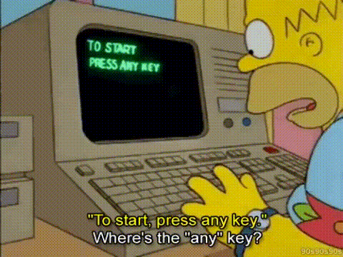
And about the demo?

Slide 14
Referências
Java 11 - OpenJDK: https://openjdk.java.net/groups/net/httpclient/intro.html
Junit 5: https://junit.org/junit5/docs/current/user-guide/
Rest Functions: https://tcanascimento.github.io/functional-rest/

Slide 15
¡Feliz TDC!
Any questions?
Get in touch
https://www.linkedin.com/in/rsaccoll
https://www.linkedin.com/in/tcanascimento

Slide 16


